Slide 1



Avances en Cancer de Mama Metastásico RH+ Her2-
Dr. Adrián Agustín Nervo

Slide 2

Avances en Cancer de Mama Metastásico
RH+ Her2-
5

Slide 3
Tratamiento sistémico del CMM
Factores pronósticos y predictivos
Subtipos moleculares
El subtipo molecular se relaciona con la sobrevida desde el diagnóstico de
Kennecke y col, J Clin Oncol 2010; 28: 3271

Slide 4
Cancer de Mama RH+
75% de los cáncer de mama son hormonodependientes ( RH +)
La terapia hormonal es el standard of care para estas pacientes.
Importantes desarrollos en los últimos años han ofrecido tratamiento promisorios y mejor calidad vida para estas pacientes ( RH+ Her2-)

Slide 5
Recomendaciones para HR+/HER2–
Cancer de Mama avanzado HR+/HER2–
Crisis visceral
SI
NO
Considerar
QT
HT
Progresion o toxicidad inaceptable
No beneficio clínico luego de 3 regimenes consecutivos de HT
Quimioterapia
.
1. National Comprehensive Cancer Network. NCCN Clinical Practice Guidelines in Oncology: Breast Cancer. V.2.2013; 2. Osborne CK, et al. Annu Rev Med. 2011;62:233-247.

Slide 6
Terapia endócrina inicial en mujeres posmenopáusicas con CMM RH+
AI son el SOC del tratamiento inicial de mujeres postmenopáusicas con CMM RH+ HER2-
IA:mayor eficacia vs tamoxifeno
HD Fulvestrant mayor eficacia comparado con anastrozol : FIRST: 23.4 vs 13.1 HR:0.66 (FASE II).
Beneficios marginales de la terapia combinada para el tratatmiento inicial: FACT y SWOG S0226: HR:0.80 P: 0.007
Combination Strategy
FACT: FUL + ANA vs ANA⁶ | 55.1 vs 55.0 | 33.6 vs 31.8 | 10.8 vs 10.2 | —
SWOG S0226: ANA + FUL vs ANA⁷ | — | — | — | 15.5 vs 13.5

Slide 7
CMM RH+ Her2-
2º línea de Tratamiento
Treatments | CBR (%) | ORR (%) | TTP (mo) | PFS (mo)
FUL vs ANA¹ | 43.5 vs 40.9 | 19.2 vs 16.5 | 5.5 vs 4.1 | —
EFECT: FUL vs EXE² | 32.2 vs 31.5 | 7.4 vs 6.7 | 3.7 vs 3.7 | —
CONFIRM: FUL 500 mg vs FUL 250 mg³ | 45.6 vs 39.6 | 9.1 vs 10.2 | — | 6.5 vs 5.5
SoFeA: FUL + ANA vs FUL vs EXE⁴ | — | 7.4 vs 6.9 vs 3.6 | — | 4.4 vs 4.8 vs 3.4
1. Robertson JFR, et al. Cancer. 2003;98(2):229-238; 2. Chia S, et al. J Clin Oncol. 2008;26(10):1664-1670; 3. Di Leo A, et al. J Clin Oncol. 2010;28(30):4594-4600; 4. Johnston S, et al. EBCC, 2012; abstract LBA2.

Slide 8


Cancer de Mama Metastásico RH+ Her2-
Respuesta a la HT
R
E
S
I
S
T
E
N
C
I
A
40 %
30 %
25 %
15 %
1 línea
2 línea
3 línea
4 línea

Slide 9
Cancer de mama Avanzado HR+/HER2–
La progresión de enfermedad es un desafío frecuente:
  Resistencia primaria, innata o de novo a la exposición inicial a la hormonoterapia
  Resistencia adquirida o secundaria, manifiesta a lo largo del tiempo luego de respuesta inicial al tratamiento hormonal
1. Bachelot T, et al. Breast Cancer Res Treat. 2010;100(suppl 1)SABCS 2010:Abstract S1-6;
2. Osborne CK, et al. Ann Rev Med. 2011;62:233–247

Slide 10

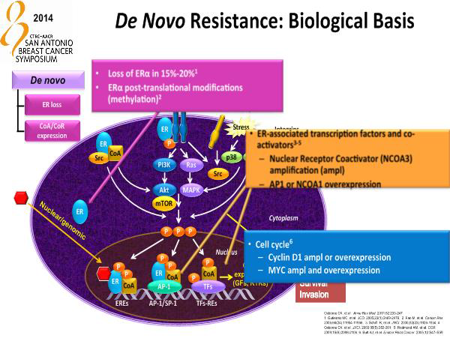
Cancer de mama Avanzado HR+/HER2–

Slide 11

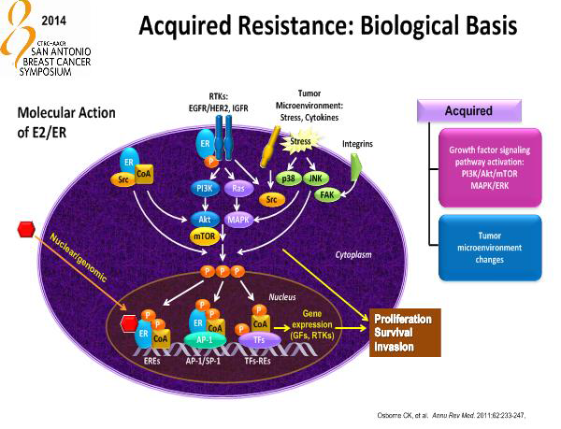
Cancer de mama Avanzado HR+/HER2–

Slide 12
BOLERO-2: Phase III Study of Exemestane ± Everolimus in Patients with ABC Progressing After NSAIs
  N = 724
  PMW with HR+, HER2– ABC refractory to LET or ANA, defined as
  Recurrence during or within 12 months after end of adjuvant treatment, or
  Progression during or within 1 month after end of treatment for advanced disease
Everolimus 10 mg/day +
Exemestane 25 mg/day
(n = 485)
Primary endpoint:
PFS
Secondary endpoints:
OS, ORR, CBR, safety, QoL, bone markers
Placebo +
Exemestane 25 mg/day
(n = 239)
Stratification
  Sensitivity to prior hormonal therapy
  Presence of visceral disease
No crossover
25. Baselga J, et al. N Engl J Med. 2012;366:520-529.
Notes:
12

Slide 13
BOLERO-2: PFS
100
Median PFS, Mos
EVE + EXE: 7.82
PBO + EXE: 3.19
Hazard ratio: 0.45 (95% CI: 0.38-0.54; log-rank P < .0001)
Censoring times
EVE + EXE (n/N = 310/485)
PBO + EXE (n/N = 200/239)
80
60
Probability of Event (%)
40
20
0
0
6
12
18
24
30
36
42
48
54
60
66
72
78
84
90
96
102
108
114
120
Wk
Patients at Risk, n
EVE + EXE
485
436
366
304
257
221
185
158
124
91
66
50
35
24
22
13
10
8
2
1
0
PBO + EXE
239
190
132
96
67
50
39
30
21
15
10
8
5
3
1
1
1
0
0
0
0
28. Piccart-Gebhart M, et al. ASCO 2012. Abstract 559.
25. Baselga J, et al. N Engl J Med. 2012;366:520-529.
Notes:
CI, confidence interval; EVE, everolimus; EXE, exemestane; PBO, placebo.

Slide 14
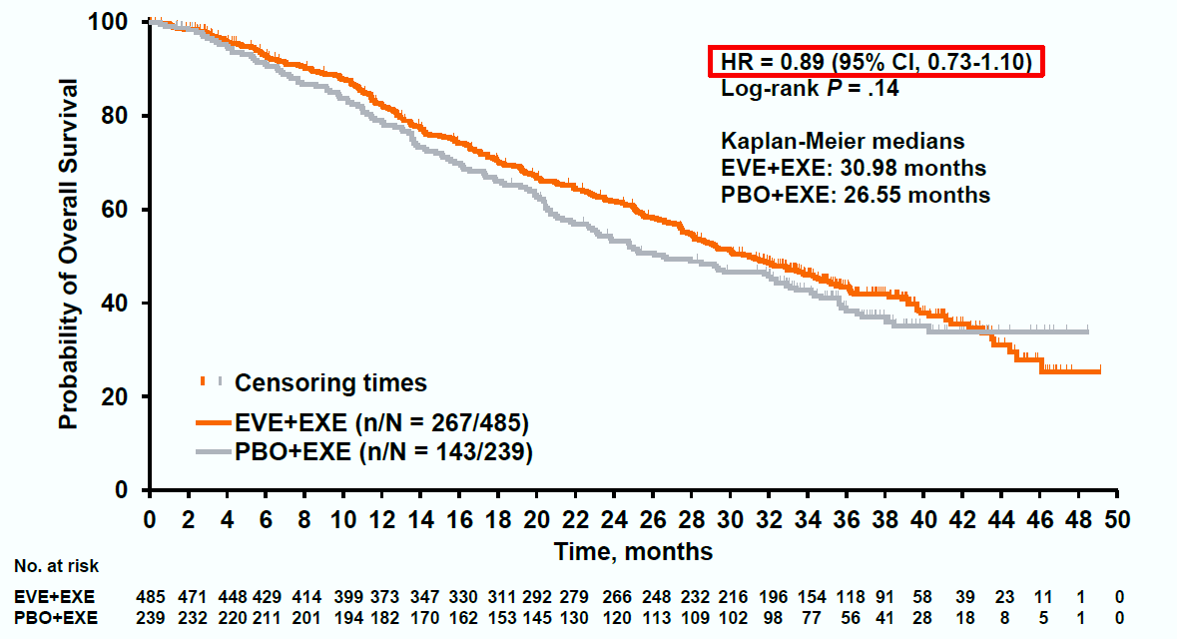
BOLERO-2 : análisis final de OS (39-meses)
4.4-meses
Piccart M, et al. Presented at EBCC-9; 19-21 March 2014; Glasgow, Scotland. Abstract 1LBA.

Slide 15


SABCS 2014
RH+
Her2-

Slide 16
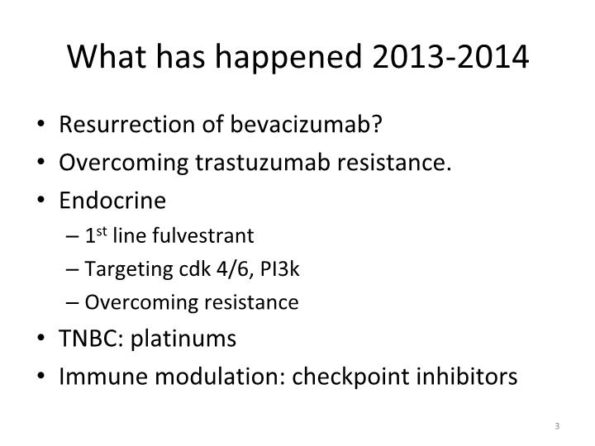
Cancer de mama metastásico

Slide 17

Terapia Hormonal y sus potenciales nuevos amigos
Inhibidores PI3k
Inhibidores cDK4-6
Inhibidores mTOR

Slide 18

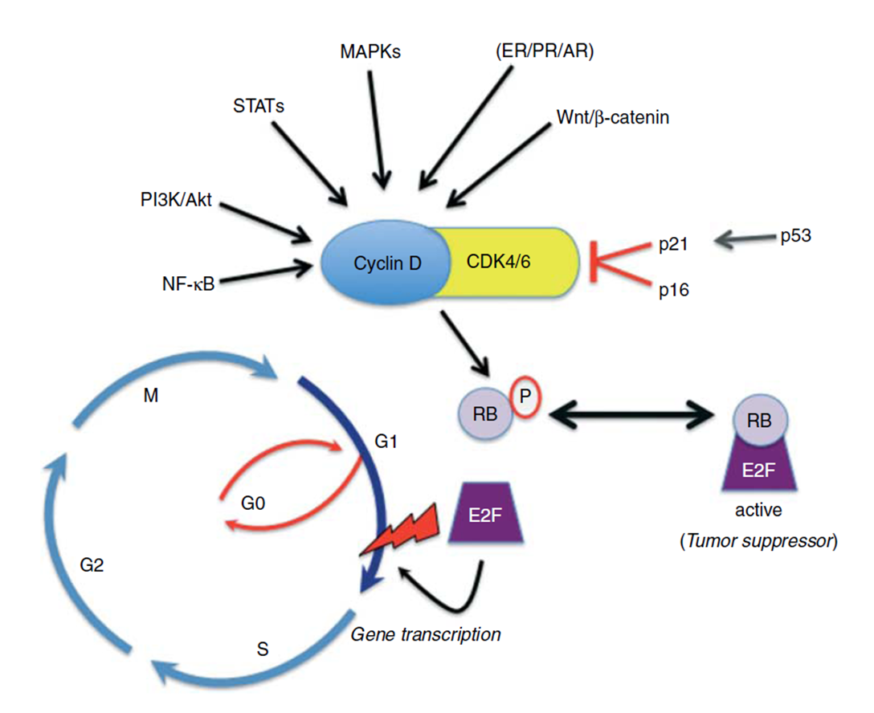
Ciclinas-CDK 4/6 como Target
CDK 4/6
Activa la Invasión y
diseminación Sistémica

Slide 19
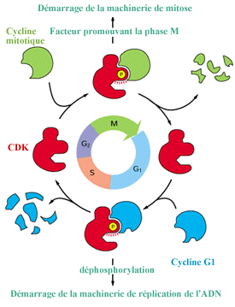
Control del Ciclo Celular
PROTEÍNAS CLAVE:
Quinasas dependientes de ciclina o Cdk
Ciclinas
Punto de control 1:
Cdk 4/6 + Ciclina G1
Quinasa de inicio
Comienza fase S Duplicación ADN
BIOLOGIA CELULAR Y MOLECULAR DE ROBERTIS
De Robertis , Eduardo D. P. / Hib , Jose

Slide 20
Control del Ciclo Celular
Punto de control 2:
Cdk1 + ciclina mitótica
Factor promotor de Mitosis Mitosis
PROTEÍNAS CLAVE:
Quinasas dependientes de ciclina o Cdk
Ciclinas
BIOLOGIA CELULAR Y MOLECULAR DE ROBERTIS
De Robertis , Eduardo D. P. / Hib , Jose

Slide 21

Regulación del Checkpoint G1/S en Cancer de Mama
D-type cyclins regulated in response to mitogenic stimuli, including activation of RTKs and steroid hormone receptors¹
Pl3K/Akt
ER/PR/AR
Wnt/β-catenin
NF-κB
STATs
MAPKs
p53
p21
CDK 4/6
inhibitors
Cyclin D
Active tumour suppressor
CDK4/6
E2F
RB
p16
M
G0
G1
R
Cyclin D1 is amplified in 15%–20% of breast cancers^{2,3}
Human ER+ breast cancer cell lines (including those with HER2 amplification) sensitive to G0/G1 arrest⁴
E2F
Gene transcription
P
P
RB
G2
S
P
P
Inactive
Lange, et al. Endocr Rel Cancer. 2011;18:C19-C24; 1. Caldon CE, et al. J Cell Biochem. 2006;97:261-274; 2. Buckley MF, et al. Oncogene. 1993;8:2127-2133; 3. Dickson C, et al. Cancer Lett. 1995;90:43-50; 4. Finn RS, et al. Breast Cancer Res. 2009;11:R77.
21
Notes:
Mitogenic signals converge at the level of cyclin D1 upregulation and CDK4/6 association, localization, and kinase activity. CDK4/6 phosphorylates and inactivates RB tumor suppressor proteins, leading to dissociation of E2F transcription factors and transcriptional regulation of genes important for G1/S transition and cell cycle progression through the restriction point.
Phosphorylation of the Rb protein early in G1 by CDK4 or CDK6 is central to the regulation of the G1 to S transition and cellular commitment to division
Aberrations of the G1S checkpoint are involved in the pathogenesis of many human cancers

Slide 22
Palbociclib (PD0332991)
Oral, highly selective inhibitor of CDK4/6
Prevents cell-cycle progression from G1 to S phase
  In vitro activity in Rb-positive tumour cell lines and primary tumours
  Low nanomolar concentrations block Rb phosphorylation, inducing G1 arrest in sensitive cell lines
CDK (cyclin partner) | IC₅₀ (µM)
CDK4 (cyclin D1) | 0.011
CDK4 (cyclin D3) | 0.009
CDK6 (cyclin D2) | 0.015
CDK2 (cyclin A) | >5
CDK1 (cyclin B) | >5
CDK5 (p25) | >5
PD-0332991
1. Fry DW, et al. Mol Cancer Ther. 2004;3:1427-1438; 2. Menu E, et al. Cancer Res. 2008;68:5519-5523; 3. Sutherland RL, Musgrove EA. Breast Cancer Res. 2009;11:112. Palbociclib (PD-0332991) is an investigational compound
22

Slide 23
The cyclin-dependent kinase 4/6 inhibitor palbociclib in combination with letrozole versus letrozole alone as first-line treatment of oestrogen receptor-positive, HER2-negative, advanced breast cancer (PALOMA-1/TRIO-18): a randomised phase 2 study
Finn RS, Crown JP, Lang I, Boer K, Bondarenko IM, Kulyk SO, Ettl J, Patel R, Pinter T, Schmidt M, Shparyk Y, Thummala AR, Voytko NL, Fowst C, Huang X, Kim ST, Randolph S, Slamon DJ.
Lancet Oncology. E-pub December 16, 2014.

Slide 24
PALOMA-1 (TRIO-18): Randomised Phase II Trial
Part 1: All Comers
Part 2: Biomarker-Positive
R
A
N
D
O
M
I
S
A
T
I
O
N
R
A
N
D
O
M
I
S
A
T
I
O
N
PD0332991 125 mg QDª + Letrozole
2.5 mg QD
PD0332991 125 mg QDª + Letrozole
2.5 mg QD
1:1
ER+, HER2– BC with CCND1 amp and/or loss of p16
ER+, HER2– BC
1:1
Letrozole
2.5 mg QD
Letrozole
2.5 mg QD
N = 66
N = 99
Postmenopausal women, first line ER+/HER2–, RECIST measureable or bone only
Primary endpoint: PFS (powered for 50% improvement; 9 >13.5 months
Analyses presented: IMPAKT 2012, SABCS 2012, AACR 2014 (final)
Publication embargo in place for results presentation
1. Clinicaltrials.gov; NCT00721409 2. Finn RS, et al SABCS; December 4-8, 2012; San Antonio, TX. Abstract S1-6. ªSchedule 3/1

Slide 25
PALOMA-1/TRIO-18:
Patient Baseline Characteristics
 | Combined |  | Cohort 1 |  | Cohort 2
Characteristic | PAL + LET (n=84) | LET (n=81) | PAL + LET (n=34) | LET (n=32) | PAL +LET (n=50) | LET (n=49)
Median (IQR) age, years | 63 (54–71) | 64 (56–70) | 66 (56–72) | 64 (57–70) | 62 (54–70) | 63 (56–71)
ECOG PS, n (%) 0 1 | 46 (55) 38 (45) | 45 (56) 36 (44) | 23 (68) 11 (32) | 20 (63) 12 (38) | 23 (46) 27 (54) | 25 (51) 24 (49)
Disease stage, n (%) III IV | 2 (2) 82 (98) | 1 (1) 80 (99) | 2 (6) 32 (94) | 0 32 (100) | 0 50 (100) | 1 (2) 48 (98)
Disease site,* n (%) Visceral Bone Other (non-visceral) | 37 (44) 17 (20) 30 (36) | 43 (53) 12 (15) 26 (32) | 10 (29) 7 (21) 17 (50) | 11 (34) 6 (19) 15 (47) | 27 (54) 10 (20) 13 (26) | 32 (65) 6 (12) 11 (23)
ECOG PS=Eastern Cooperative Oncology Group performance status; IQR=interquartile range; LET=letrozole; PAL=palbociclib.
*Based on CRF data. All data were available for all patients.
Finn et al. Lancet Oncol. E-pub Dec 16, 2014

Slide 26
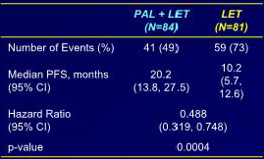
PALOMA-1/TRIO-18: PFS (ITT Population)
100
90
Palbociclib plus letrozole
Letrozole
80
70
60
Progression-free survival, %
50
40
30
20
10
HR 0.488 (95% CI 0.319–0.748; one-sided P=0.0004)
0
0
4
8
12
16
20
24
28
32
36
40
Number at risk
Time, months
Palbociclib plus letrozole
84
67
60
47
36
28
21
13
8
5
1
Letrozole
81
48
36
28
19
14
6
3
3
1
Finn et al. Lancet Oncol. E-pub Dec 16, 2014

Slide 27
PALOMA-1/TRIO-18: PFS (Cohorts)
Cohort 1
Cohort 2
Palbociclib plus letrozole
Letrozole
100
100
90
90
80
80
70
70
60
60
Progression-free survival, %
50
50
40
40
30
30
20
20
10
10
0
HR 0.299 (95% CI 0.156–0.572; one-sided P=0.0001)
0
HR 0.508 (95% CI 0.303–0.853; one-sided P=0.0046)
0
4
8
12
16
20
24
28
32
36
40
0
4
8
12
16
20
24
28
32
36
40
Time, months
Time, months
Number at risk
Palbociclib plus letrozole
34
26
23
18
15
13
11
8
8
5
1
50
41
37
29
21
15
10
5
Letrozole
32
15
10
8
5
4
4
3
3
1
49
33
26
20
14
10
2
Finn et al. Lancet Oncol. E-pub Dec 16, 2014

Slide 28
PALOMA-1/TRIO-18: Forest Plot for PFS
PAL + LET
LET
Hazard ratio
(95% CI)
Interaction
P value*
Patients
Events
Patients
Events
All patients (intention-to-treat population)
84
41
81
59
0.488 (0.319–0.748)
Cohort
1
34
15
32
25
0.299 (0.156–0.572)
0.14
2
50
26
49
34
0.508 (0.303–0.853)
Age group (years)
<65 years
47
24
42
35
0.315 (0.184–0.539)
0.34
≥65 years
37
17
39
24
0.505 (0.269–0.948)
Baseline ECOG performance status
0
46
21
45
31
0.434 (0.246–0.766)
0.78
1
38
20
36
28
0.398 (0.220–0.721)
Disease site
Visceral
37
21
43
34
0.547 (0.317–0.944)
Bone Only
17
5
12
7
0.294 (0.092–0.945)
0.44
Other
30
15
26
18
0.402 (0.200–0.808)
Previous chemotherapy
Yes
34
17
37
24
0.479 (0.255–0.898)
0.75
No
50
24
44
35
0.397 (0.234–0.671)
Previous antihormonal therapy
Yes
27
12
28
19
0.460 (0.222–0.956)
0.88
No
57
29
53
40
0.397 (0.244–0.646)
Previous systemic therapy
Yes
40
20
44
28
0.539 (0.302–0.962)
0.36
No
44
21
37
31
0.341 (0.194–0.599)
Time from end of adjuvant treatment to disease recurrence
≤12 months (including de-novo presentation)
59
31
51
39
0.418 (0.259–0.674)
0.95
>12 months
25
10
30
20
0.399 (0.185–0.858)
0.34
≤12 months (excluding de-novo presentation)
15
7
14
5
0.765 (0.232–2.523)
0.062
0.125
0.250
0.500
1.000
2.000
4.000
Adju. Trt.=adjuvant treatment; Dis. Recur.=disease recurrence; ECOG PS=Eastern Cooperative Oncology Group performance status; LET=letrozole; PAL=palbociclib.
*Two-sided P value.
Favours palbociclib plus letrozole
Favours letrozole
Finn et al. Lancet Oncol. E-pub Dec 16, 2014

Slide 29
PALOMA-1/TRIO-18: Overall Survival (ITT Population)
100
Palbociclib plus letrozole
90
Letrozole
80
70
60
Overall survival, %
50
40
30
20
10
HR 0.813 (95% CI 0.492–1.345; two-sided P=0.42)
0
0
4
8
12
16
20
24
28
32
36
40
44
Time, months
Number at risk
Palbociclib plus letrozole
84
80
78
73
68
65
47
35
22
17
7
2
Letrozole
81
76
74
67
64
59
37
23
14
12
5
1
With only 30 events in the palbociclib plus letrozole arm and 31 events in the control arm, the study was not powered to demonstrate an overall survival advantage; initial data suggest there is no detrimental effect on OS by adding palbociclib
A follow-up overall survival analysis will be performed after the accrual of additional events
Finn et al. Lancet Oncol. E-pub Dec 16, 2014

Slide 30
PALOMA-1/TRIO-18: All-Causality AEs Occurring in ≥10% of Patients (Safety Population)
Adverse event, % | PAL + LET (n=83) |  | LET (n=77)
 | All grades | Grade 3/4 | All grades | Grade 3/4
Any adverse event | 99 | 76 | 84 | 21
Neutropenia | 75 | 54 | 5 | 1
Leukopenia | 43 | 19 | 3 | 0
Fatigue | 41 | 5 | 23 | 1
Anemia | 35 | 6 | 6 | 1
Nausea | 25 | 2 | 13 | 1
Arthralgia | 23 | 1 | 16 | 3
Alopecia | 22 | n/a | 3 | n/a
Diarrhea | 20 | 4 | 10 | 0
Hot flush | 21 | 0 | 12 | 0
Thrombocytopenia | 17 | 2 | 1 | 0
Decreased appetite | 16 | 1 | 7 | 0
Dyspnea | 16 | 2 | 8 | 1
Nasopharyngitis | 16 | 0 | 10 | 0
Back pain | 11 | 0 | 16 | 1
LET=letrozole; n/a=not applicable; PAL=palbociclib.
One (1%) grade 5 event occurred in the PAL + LET group (from disease progression); none occurred in the LET group.
No cases of febrile neutropenia were reported
Finn et al. Lancet Oncol. E-pub Dec 16, 2014

Slide 31

PALOMA-1
The combination of palbociclib and letrozole compared with letrozole alone showed statistically significant improvement in median PFS in patients with ER+/HER2– breast cancer at final analysis (AACR, 2014)
The combination is generally well tolerated, with uncomplicated neutropenia as the most frequent adverse event
A confirmatory phase 3 study (PALOMA-2) is fully enrolled and ongoing
FDA
February 2015

Slide 32
Palbociclib en HR+/HER2– BC: estudios fase III
 | Metastatic Breast Cancer |  |  | Post-Neoadjuvant
Study | 1008 (PALOMA-2) | 1023 (PALOMA-3) | PEARL | PENELOPE
Setting | Endocrine sensitive | Endocrine resistant | Endocrine resistant | High risk
Menopausal status | Postmenopausal | Premenopausal + postmenopausal | Postmenopausal | Premenopausal + postmenopausal
No. of patients | 650 | 521 | 348 | 800
Treatment | Palbociclib + letrozole vs placebo + letrozole | Palbociclib + fulvestrant vs placebo + fulvestrant | Palbociclib + exemestane vs capecitabine | Palbociclib vs placebo
Primary endpoint | PFS | PFS | PFS | iDFS
FFPV, first patient first visit; iDFS, invasive disease-free survival; PFS, progression-free survival.
Clinicaltrials.gov.Paloma 2: NCT01740427, Paloma 3: NCT 01942135; Pearl: NCT02028507 Penelope: NCT01864746

Slide 33
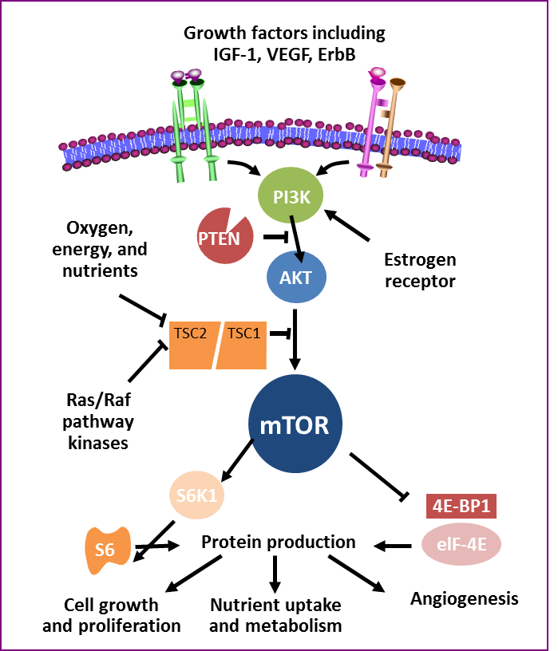
Vía PI3k/AKT/mTOR como Target
PI3K/AKT/mTOR
Activa la Invasión y
diseminación Sistémica

Slide 34
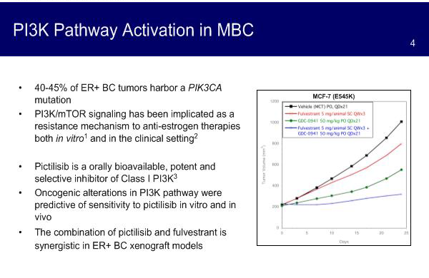
Inhibidores PI3k: pectilisib
Activacion PI3K en cáncer de mama

Slide 35
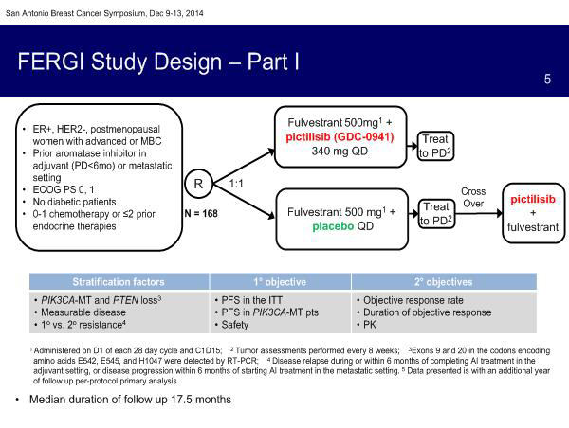
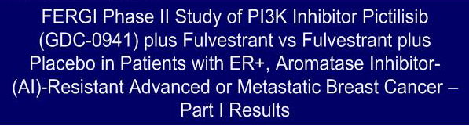
Inhibidores PI3k: pectilisib

Slide 36
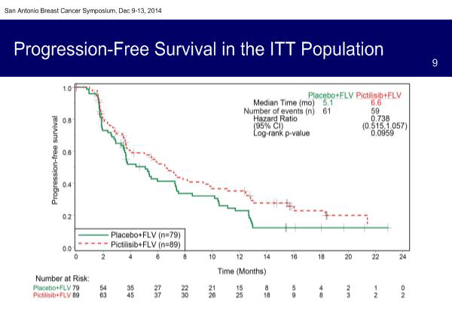

Inhibidores PI3k
Inhibidores PI3k: pectilisib

Slide 37
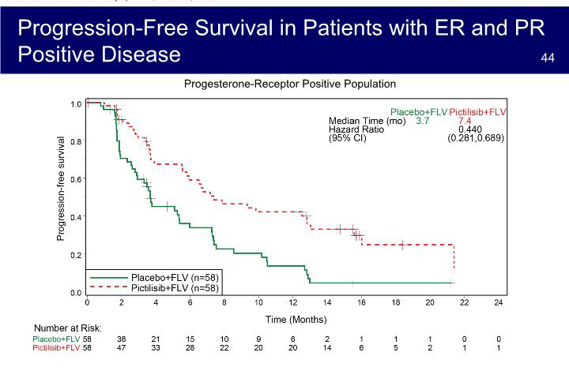
Inhibidores PI3k: pectilisib

Slide 38
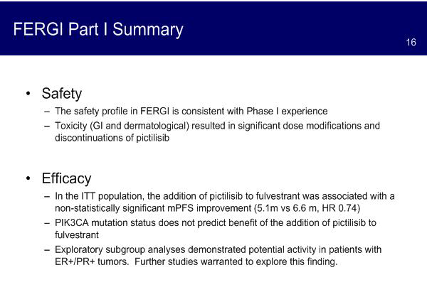
Inhibidores PI3k: pectilisib

Slide 39

CONCLUSIONES

Slide 40
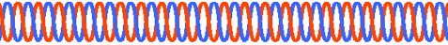
Combinacion de Targets y Antiestrógenos en CMM RH+
EGFR
HER2
E
Aromatase Inhibitor
Nonsteroidal AIs
  Anastrozole
  Letrozole
  Steroidal AIs
  Exemestane
Inhibidores PI3k
pectilisib
P
P
TKI
E
RAS
PI3K
PTEN
RAF
ER Downregulator
Fulvestrant
E
mTOR Inhibitors
Everolimus
AKT
ER
MEK
MAPK
mTOR
Selective Estrogen Receptor Modulators
Tamoxifen
Toremifene
CDK 4/6 Inhibitor
PALBOCICLIB
Cell
Cycle
E
E
ER target gene transcription
HDAC Inhibitor
Entinostat
ER
ER
Transcription
Silencing
Notes:
AI, aromatase inhibitor; E, estrogen; ER, estrogen receptor; HR, hormone receptor; mTOR, mammalian target of rapamycin; TKI, tyrosine kinase inhibitor.

Slide 41



Evolución Tratamiento en Cancer de Mama RH+ Her2-
Que hubo de nuevo en San Antonio ??
Anti Cdk4/6
Palbociclib (2015)
Letrozole (1997)
Fulvestrant (2002)
Toremifene (1997)
Everolimus + exemestane
(2012)
Tamoxifen (1977)
Inhibidores PI3k
Anastrozole (1995)
1936 | 1975 | 1980 | 1985 | 1990 | 1995 | 2000 | 2005 | 2010 | 2015
Nada que cambie el SOC de tratamiento actual
Palbociclib SABCS 2013 – FDA 2015

Slide 42
MUCHAS GRACIAS!

