Slide 1



Revisión de enfermedad HER2 +
  Mark M. Moasser, MD
  Helen Diller Family Comprehensive Cancer Center
  University of California, San Francisco
Valeria Caceres, M.D., Ph.D.
Instituto Angel H Roffo
Universidad de Buenos Aires
Buenos Aires , 23 de abril de 2015

Slide 2
San Antonio Breast Cancer Symposium, December 9-13, 2014
San Antonio Breast Cancer Symposium, December 9-13, 2014
Mechanisms of HER2 signaling, targeting, and resistance
Mark M. Moasser, MD
Helen Diller Family Comprehensive Cancer Center
University of California, San Francisco
This presentation is the intellectual property of the author/presenter.
Contact mark.moasser@ucsf.edu for permission to reprint and/or distribute.

Slide 3
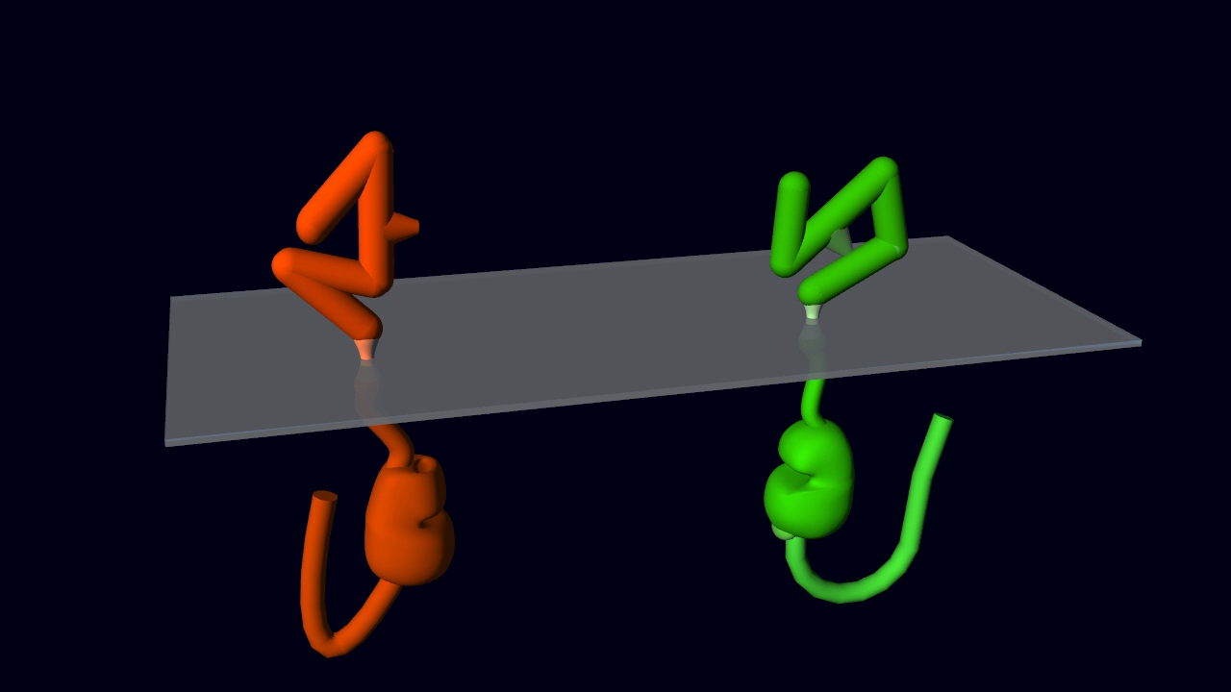
San Antonio Breast Cancer Symposium, December 9-13, 2014
Ogiso et al, Cell 2002; 110: 775.
(EGFR+EGF ECD dimer)
phosphorylated
membrane lipids
(PIP3)
Garrett TP et al, Cell 2002; 110: 763.
(EGFR ECD+TGFa)
Schulze et al, Mol Sys Biol 2005; 25: msb4100012
Jones et al, Nature 2006; 439: 168-74.
closed/tethered conformation
cannot dimerize
Ferguson KM et al, Mol Cell 2003; 11: 507. (inactive EGFR ECD)
Garrett TP et al (2003); Mol Cell 11; p495 (HER2 ECD)
Cho HS et al, Nature 2003; 421: 756. (HER2 ECD +/- tras)
dimerization interface
Cho HS & Leahy DJ, Science 2002; 297: 1330. (HER3 ECD)
Bouyain et al, PNAS 2005; 110: 15024. (HER4 ECD)
Leahy
Lemmon
Ward
Yokoyama
Kuriyan
Ras
PTEN
Wu et al, PNAS 1998; 95: 15587–91.
Bocharov et al,
JBC 2008; 283:6950. (HER2 TM dimer)
Raf
HER2
HER3
PI3K
HER3
HER2
Akt
Jura et al,
Cell 2009; 137:1293. (EGFR JM)
Stamos et al, JBC 2002; 277: 46265. (EGFR KD+erl)
Wood et al, Cancer Res, 2004; 64: 6652. (EGFR KD+lap)
Jura et al, PNAS 2009; 106: 21608. (HER3 KD)
Shi et al, PNAS 2010; 107: 7692. (HER3 KD)
phosphorylations
phosphorylations
kinase activation
MEK
Physiologic signaling
Soltoff et al (1994), MCB 14 p3550
Prigent & Gullick (1994), EMBO J 13 p2831.
Zhang et al, Cell 2006; 125:1137. (EGFR KD dimer)
Qiu et al, Structure 2008; 16:460. (HER4 KD dimer)
This presentation is the intellectual property of the author/presenter.
Contact mark.moasser@ucsf.edu for permission to reprint and/or distribute.

Slide 4
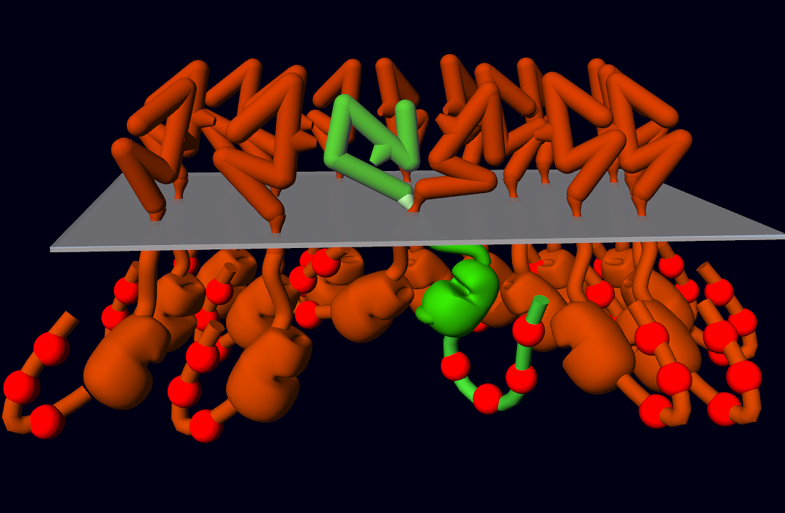
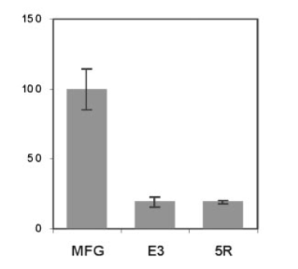
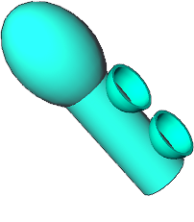
San Antonio Breast Cancer Symposium, December 9-13, 2014
HER3 is essential in
HER2-driven tumorigenesis
SkBr3 tumor monolayer
Holbro et al, PNAS 2003; 100: 8933.
BT474 tumor xenograft
Lee-Hoeflich et al, Cancer Res 2008; 68: 5878.
MMTV-Neu-IRES-Cre / HER3 fl/fl
HER3
PI3K
Pathologic signaling
HER2 over-expression
(HER2-positive breast cancer)
Vaught et al, Cancer Res 2012
This presentation is the intellectual property of the author/presenter.
Contact mark.moasser@ucsf.edu for permission to reprint and/or distribute.

Slide 5
San Antonio Breast Cancer Symposium, December 9-13, 2014
Targeting HER2
for the treatment of HER2-amplified breast cancer
mechanisms of action
mechanisms of resistance
predictive biomarkers
This presentation is the intellectual property of the author/presenter.
Contact mark.moasser@ucsf.edu for permission to reprint and/or distribute.

Slide 6
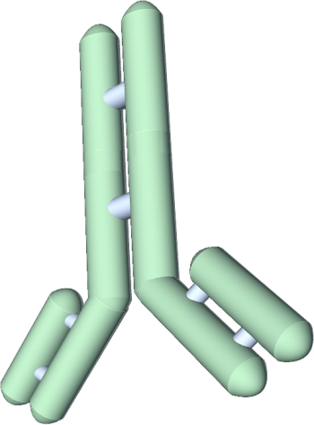
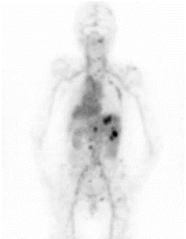
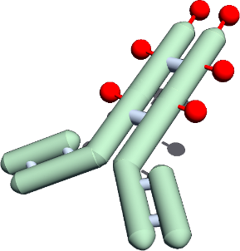
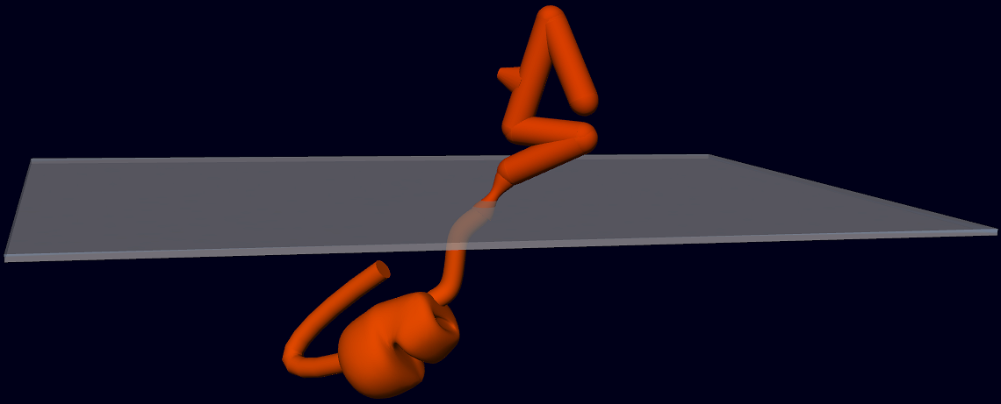
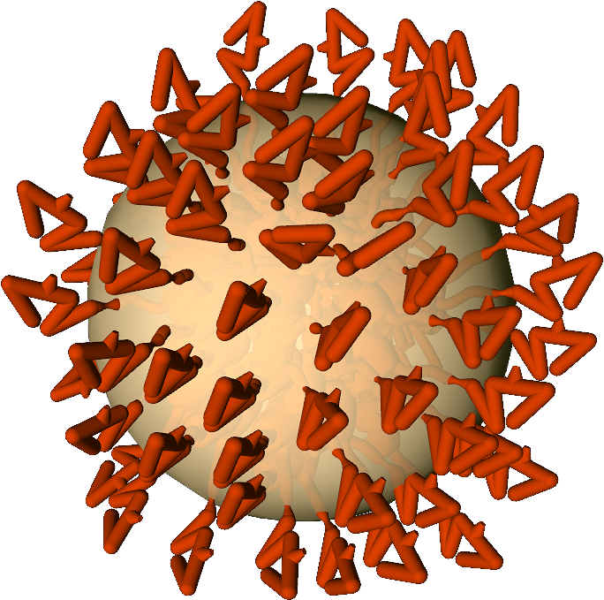
San Antonio Breast Cancer Symposium, December 9-13, 2014
HER2 inhibition
HER2 homing
pertuzumab
89Zr-trastuzumab PET
Franklin et al, Cancer Cell 2004; 5:317.
trastuzumab
Cho et al, Nature 2003; 421:756.
Rusnak et al, Mol Cancer Ther 2001; 1: 85-94.
lapatinib
tumors
Rabindran et al, Cancer Res 2004; 64: 3958-65.
neratinib
Minkovsky et al, Curr Op Inv Drugs 2008; 9: 1336.
afatinib
erlotinib
Dijkers et al, Clin Pharmacol Ther. 2010; 87:586
Schaefer et al, Cancer Res 2007; 67: 1228-38
Gendreau et al, Clin Cancer Res 2007; 13: 3713-23.
XL647
HER2
This presentation is the intellectual property of the author/presenter.
Contact mark.moasser@ucsf.edu for permission to reprint and/or distribute.

Slide 7
San Antonio Breast Cancer Symposium, December 9-13, 2014
HER2 homing
immuno-drug-conjugates
T-DM1 (trastuzumab-emtansine)
Lewis-Phillips et al, Cancer Res 2008; 68: 9280.
Verma et al, NEJM 2012; 367: 1783-1791.
immuno-liposomes
SYD983 (trastuzumab-vc-seco-DUBA)
MM-302
Dokter et al, Mol Cancer Ther 2014 (in press)
Park et al, Clin Cancer Res 2002; 8:1172-81
Munster et al, SABCS 2013, P4-12-29
immuno-imaging
DAR4 (TUB-OMOM–trastuzumab)
Cohen et al, Cancer Res 2014; 74: 5700-10.
immuno-therapies
⁶⁴Cu-DOTA-trastuzumab
Tamura et al, J Nucl Med. 2013; 54:1869-75
⁶⁸Ga-F(ab)₂-trastuzumab
antibodies
vaccines
Smith-Jones et al, Nat Biotechnol 2004; 22: 701-6.
⁸⁹Zr-trastuzumab
trastuzumab
peptide-based vaccines
Disis et al, J Clin Oncol 2002; 20: 2624–2632
Zaks & Rosenberg, Cancer Res 1998; 58: 4902–4908
Murray et al, Clin Cancer Res 2002; 8: 3407–3418.
Knutson et al, Clin Invest 2001; 107: 477–484.
Peoples et al, J Clin Oncol 2005; 23: 7536–7345
Dijkers et al, Clin Pharmacol Ther. 2010; 87:586
pertuzumab
immuno-radiotherapy
protein-based vaccines
Disis et al, J Clin Oncol 2004; 22: 1916–1925
Disis et al, Cancer Res 2010; 69 (24 suppl): 5102
²¹²Pb-TCMC-trastuzumab
DNA vaccines
Yong et al, Mol Cancer Ther 2012, 11: 639–648
Guardino et al, Cancer Res 2010; 69(24_suppl): 5089.
whole-cell vaccines
²²⁷Th-DOTA-trastuzumab
Emens et al, J Clin Oncol 2009; 27: 5911–5918
Abbas et al, EJNMMI Res. 201; 1:18.
dendritic cell vaccines
Brossart et al, Blood 2000; 96: 3102–3108
Czerniecki et al, Cancer Res 2007; 67: 1842–1852
Morse et al, Transl Med 2007; 5: 42
Peethambaram et al, Clin Cancer Res 2009; 15: 5937
²²⁵Ac-DOTA-trastuzumab
Ballangrud et al, Clin Cancer Res. 2004;10: 4489.
This presentation is the intellectual property of the author/presenter.
Contact mark.moasser@ucsf.edu for permission to reprint and/or distribute.

Slide 8
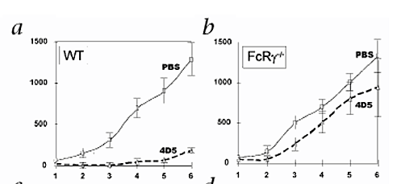

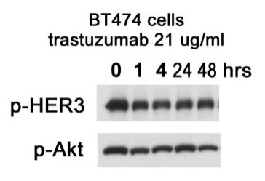
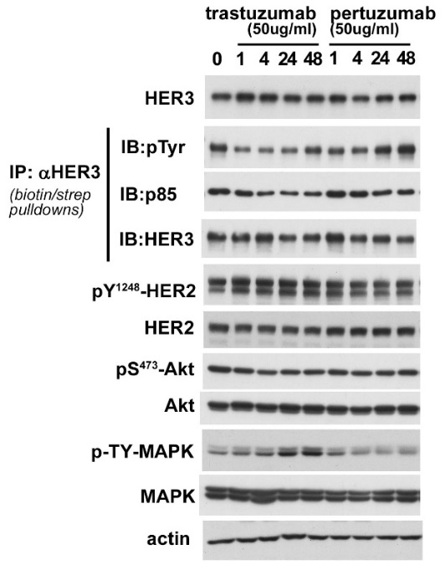
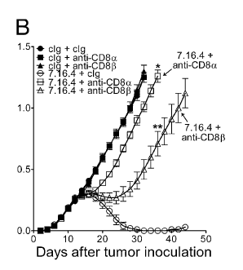
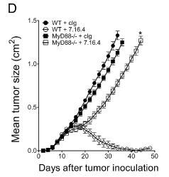
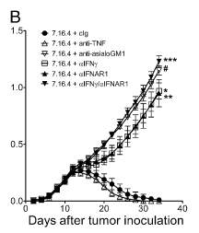

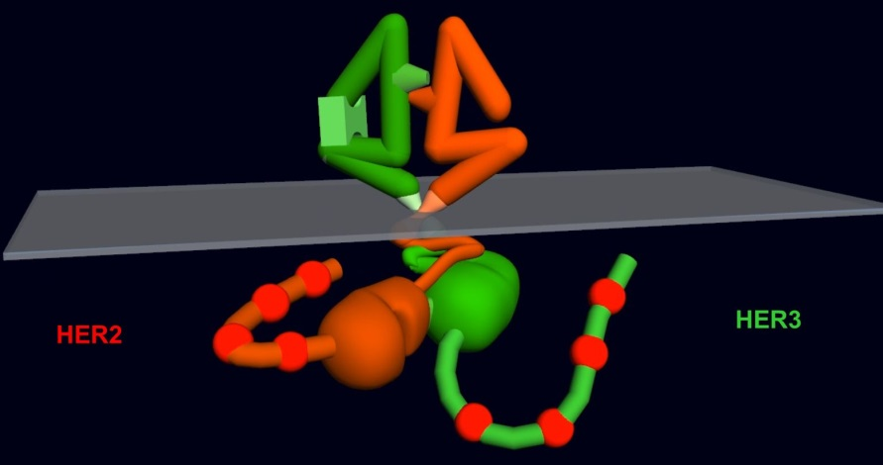
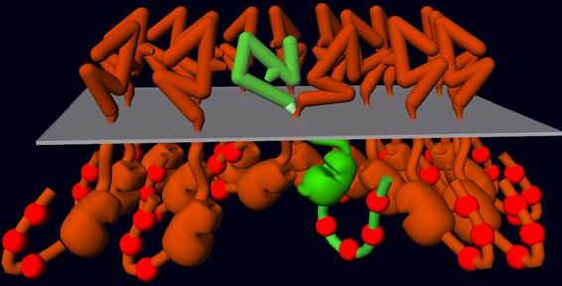
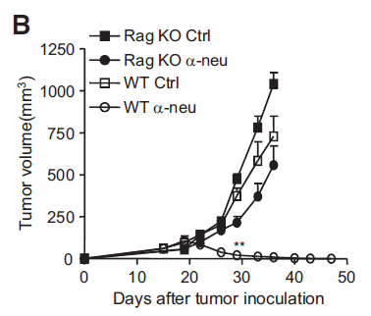
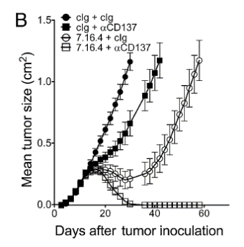
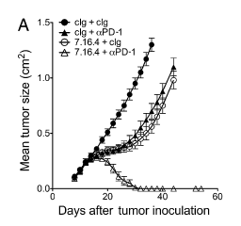
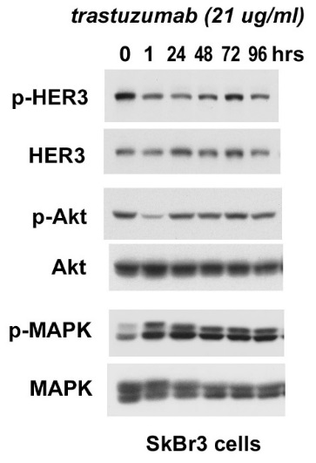
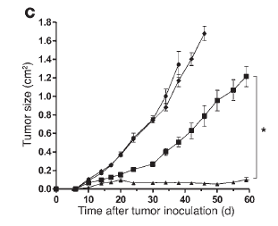
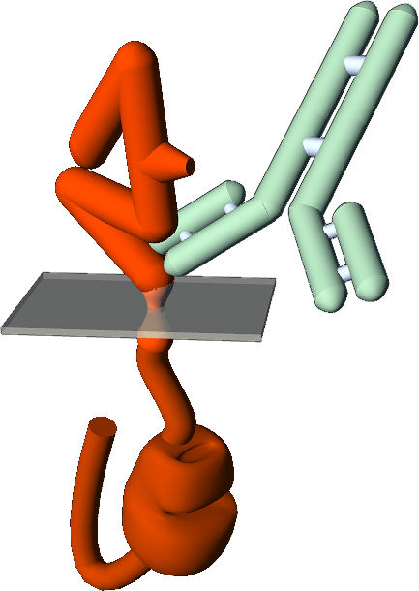
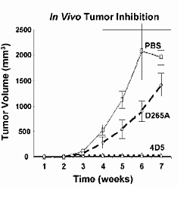
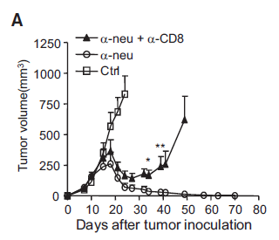
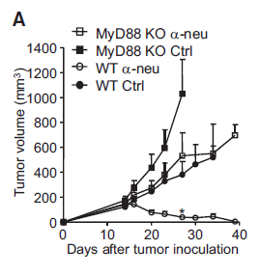
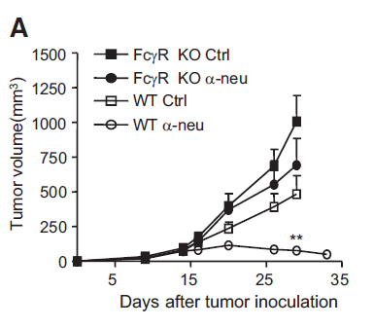
San Antonio Breast Cancer Symposium, December 9-13, 2014
HER2 inhibition
HER2 homing
immunologic targeting
Both innate and adaptive immunity engaged by
anti-HER2/Neu antibody treatment
clinical observations of immunologic effects of trastuzumab
Host immune system mediates anti-tumor effects of trastuzumab
anti-ErbB2 mAb treatment triggers MyD88-dependent signaling,
primes IFNγ-producing CD8+ T-cells
?
trastuzumab in neo-adjuvant setting:
efficacy can be enhanced by PD-1 blocking or CD137 activating mAbs
natural killer cells
CD8 T-cells
T-cell memory induced
SkBr3
CD8+ required
MyD88 required
IFNγ required
response associated with increased tumor infiltration with T-cells, macrophages, NK cells
immunocompetent model
immune competent
immunosuppressed model
Arnould et al, Br J Cancer 94:259-67, 2006
highly effective
anti-ErbB2 mAb
+
PD-1 blocking mAb
FcRγ
trastuzumab
+
CD137 activating mAb
response associated with increased tumor infiltration with leukocytes and increased anti-HER2 ADCC activity of PBMCs
anti-ErbB2 mAb
+
CD137 activating mAb
Gennari et al, Clin Cancer Res 10:5650-5, 2004
antibodies
NOAH trial – trastuzumab pCR rates associated with higher plasma cell metagene
Bianchini et al, JCO 2011; 29: suppl-abstr #529
deficient in T/B cells (Rag-1 null)
mutate the mouse
trastuzumab
NeoSphere trial – trastuzumab pCR rates associated with immune related genes
loss of efficacy
Gianni et al, SABCS 2012; S6-7
Stagg et al, PNAS 2011; 108: 7142-7147.
pertuzumab
mutate the antibody
trastuzumab in metastatic setting:
Kohrt et al, JCI 2-12; 122: 1066-75.
response associated with increased anti-HER2 ADCC activity of PBMCs
Stagg et al, PNAS 2011; 108: 7142-7147.
deficient at ADCC (FcRγ null)
Beano et al, J Transl Med 2008; 6: 25
loss of efficacy
Moasser lab (unpublished)
response associated with increased anti-HER2 T-cell activity in PBMCs
Taylor et al, Clin Cancer Res 2007; 13: 5133-43
trastuzumab treatment induces a decrease in T-reg and an increase in T-helper cells
Park et al, Cancer Cell 2010; 18: 160-170.
Park et al, Cancer Cell 2010; 18: 160-170.
Horlock et al, Br J Cancer 2009; 100: 1061-7
Perez et al, Clin Cancer Res 2007; 13: 2714
RA Clynes et al, Nature Medicine 2000; 6 p443.
This presentation is the intellectual property of the author/presenter.
Contact mark.moasser@ucsf.edu for permission to reprint and/or distribute.
Notes:
Programmed death-ligand 1 (PD-L1) is a 40kDa type 1 transmembrane protein that has been speculated to play a major role in suppressing the immune system
CD137 is a member of the tumor necrosis factor (TNF) receptor family. Its
CD137 can be expressed by activated T cells, but to a larger extent on CD8 than on CD4 T cells. In addition, CD137 expression is found on dendritic cells, follicular dendritic cells, natural killer cells, granulocytes and cells of blood vessel walls at sites of inflammation.

Slide 9
HER2 inhibition
HER 2 immunological targeting
trastuzumab
pertuzumab
p-Akt / p-S6
PIK3CA mutation
PTEN expression
immune cell infiltration
immune cell activation
cytokine secretion
tumor immuno-resistance
develop predictive biomarkers
of response/resistance
combine with:
PI3K inhibitors
Akt inhibitors
mTor inhibitors
immune stimulants
immunoresistance inhibitors
α-PD-1
α -PD-L1
α -CTLA4
develop treatments
to overcome resistance
& enhance/expand response
This presentation is the intellectual property of the author/presenter.
Contact mark.moasser@ucsf.edu for permission to reprint and/or distribute.

Slide 10
San Antonio Breast Cancer Symposium, December 9-13, 2014
Clinical studies of PIK3CA/PTEN as biomarkers
This presentation is the intellectual property of the author/presenter.
Contact mark.moasser@ucsf.edu for permission to reprint and/or distribute.

Slide 11
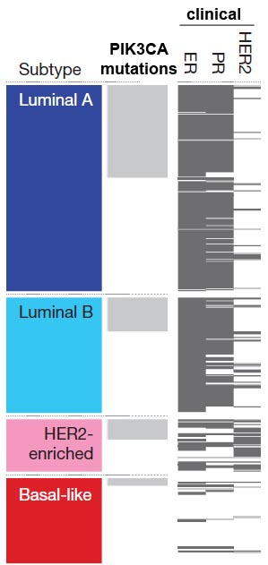
San Antonio Breast Cancer Symposium, December 9-13, 2014
Clinical studies of PTEN/PIK3CA effect on response to chemo/trastuzumab
HER2 positive neo-adjuvant studies and metastatic disease studies & case series
PIK3CA prognosis studies
Jensen et al, Ann of Oncol 2012; 23: 2034-42.
Danish adjuvant chemo/trastuzumab cohort; N=240
mPIK3CA has no effect on DFS, but worse OS
PTEN uninformative
Cizkova et al, Breast Cancer Res 2012; 14:R28
Case series at Inst. Curie; primary breast cancers; N=452
PIK3CA mutation confers better prognosis
inconclusive
Wang et al, BMC Cancer 2011; 11: 248.
Selected cohort; N=57
mPIK3CA confers worse prognosis on chemo/tras
low PTEN
no effect
Kalinsky et al, Clin Cancer Res 2009; 15: 5049-59.
MSKCC case series; primary breast cancers; N=590
PIK3CA mutation confers better prognosis
PTEN vs PIK3CA conflicting
pCR not supported by DFS/OS
relativity, not resistance markers
confounded by chemo resistance
confounded by lapatinib resistance
confounded by mPIK3CA biology
Loibl et al, JCO 2014; 32: 3212-20.
Three Gepar neo-adjuvant trials; N=504
mPIK3CA cancers have reduced pCR rate, but same DFS
PIK3CA mutation
less responsive
Murayama et al, Clin Cancer Res 2007; 13: 408-14.
Japanese case series; primary breast cancers; N=188
PIK3CA mutation confers better prognosis
good prognosis
Baselga et al, Europ Cancer Congr 2013; Abtrs #1859
NeoALLTO tras/lap trial; N=355
PIK3CA mutation confers lower pCR, DFS not reported
Perez-Tenorio et al, Clin Cancer Res 2007; 13: 3577-84.
Swedish case series; primary breast cancers; N=270
PIK3CA mutation confers better prognosis
clinical studies of PIK3CA/PTEN as biomarkers
Baselga et al, Cancer Res 2012;72(S24):Abstract nr S5-1
CLEOPATRA metastatic study, N>500
PIK3CA mutation confers worse prognosis,
but not predictive for pertuzumab; PTEN uninformative
Sanchez et al, Breast Cancer Res 2011; 13; R21
Wash U SL case series; metastatic breast cancers; N=51
PIK3CA mutation confers better prognosis
PIK3CA mutation
Contreras et al, SABCS 2013; PD1-2.
Neo-adjuvant lap/tras; N= 31
mPIK3CA or low PTEN have reduced pCR
ER positive subtype
Loi et al, PNAS 2010; 107: 10208-13.
Case series; primary breast cancers; N=173
PIK3CA mutation confers better prognosis in ER+/HER2-
Pang et al, Scientific Reports 2014; 4:6255.
Meta-analysis; N=5719
PIK3CA mutation confers better prognosis
strong correlation with ER/PR positive
Dave et al, JCO 2011; 29: 166-73.
2 neo-adjuvant trials at Baylor, N=35
PIK3CA mutation or low PTEN individually not significant,
but together correlate with reduced pCR
Barbareschi et al, Clin Cancer Res 2007; 13: 6064-9.
Italian case series; primary breast cancers; N=163
PIK3CA mutation depends on site;
confers better (exon 20) or worse (exon 9) prognosis
low PTEN
equivocal
Guarneri et al, ESMO 2014, Abtr #254O
Neoadjuvant CherLOB chemo/lap/tras study; N=106
PIK3CA mutation not significant for tras,
but significant for tras+lap resistance
PIK3CA mutation
conditional
less chemo-responsive
Saal et al, Cancer Res 2005, 65: 2554-9.
Case series Columbia & Sweden, mixed stages; N=292
PIK3CA mutation has no effect on prognosis
Berns et al, Cancer Cell 2007; 12: 395-402.
2 case series MDACC and Netherlands; N=55
PIK3CA mutation or PTEN low not significant alone,
but together confer worse prognosis on chemo/tras
Li et al, Breast Cancer Res Treat 2006; 96: 91-5.
Australian case series; primary breast cancers; N=250
PIK3CA mutation confers worse prognosis
low PTEN
less response
Fujita et al, Br J Cancer 2006; 94: 247-52.
Japanese case series; N=17
Low PTEN confers resistance to chemo/tras
The Cancer Genome Atlas Network
Nature 2012; 490: 61-70.
Mangone et al, Clinics 2012; 67: 1285-90.
Brazilian case series, primary breast cancers; N=86
PIK3CA mutation confers worse prognosis
Lai et al, Ann Surg Oncol 2008; 15: 1064-69.
Taiwan case series; primary breast cancers; N=152
PIK3CA exon 20 mutation confers worse prognosis
Nagata et al, Cancer Cell 2004; 6: 117-27.
N=47 chemo/tras; N=37 chemo
PTEN low confers resistance to chemo/tras
This presentation is the intellectual property of the author/presenter.
Contact mark.moasser@ucsf.edu for permission to reprint and/or distribute.

Slide 12
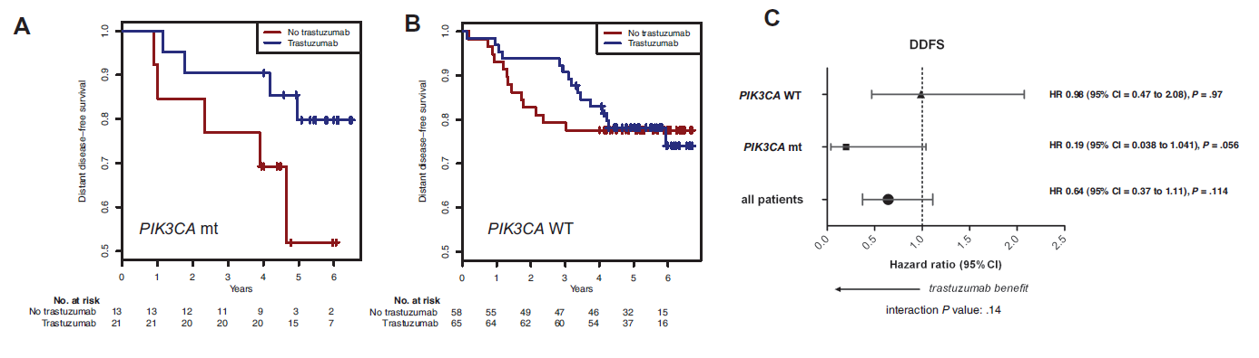
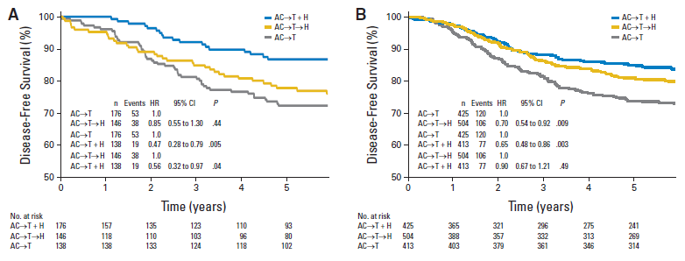
San Antonio Breast Cancer Symposium, December 9-13, 2014
FinHER adjuvant study
N=157 HER2-amplified cases genotyped for PIK3CA (21% = PIK3CA mutant)
study design required to identify and validate
a predictive biomarker of trastuzumab benefit
    independent of its prognostic readout
    independent of its short-term chemo predictive readout
    with late outcomes that supersedes all chemo/hormone effects
PIK3CA mutation does not predict trastuzumab resistance
biomarker studied
in both arms
trastuzumab
with 5 year F/U
Loi et al, JNCI 2013; 105: 960-967.
chemo
randomized
trastuzumab benefit
NCCTG N9831 + NSABP B-31 adjuvant study
N=1802 cases PTEN immunostained (25% scored 0, 75% scored 1+/2+/3+)
control
PTEN loss does not predict trastuzumab resistance
with 5 year F/U
Perez et al, JCO 2013; 31: 2115-2122.
This presentation is the intellectual property of the author/presenter.
Contact mark.moasser@ucsf.edu for permission to reprint and/or distribute.

Slide 13
HER2 inhibition
HER 2 immunological targeting
trastuzumab
pertuzumab
p-Akt / p-S6
PIK3CA mutation
PTEN expression
immune cell infiltration
immune cell activation
cytokine secretion
tumor immuno-resistance
develop predictive biomarkers
of response/resistance
combine with:
PI3K inhibitors
Akt inhibitors
mTor inhibitors
immune stimulants
immunoresistance inhibitors
α-PD-1
α -PD-L1
α -CTLA4
develop treatments
to overcome resistance
& enhance/expand response
This presentation is the intellectual property of the author/presenter.
Contact mark.moasser@ucsf.edu for permission to reprint and/or distribute.

Slide 14
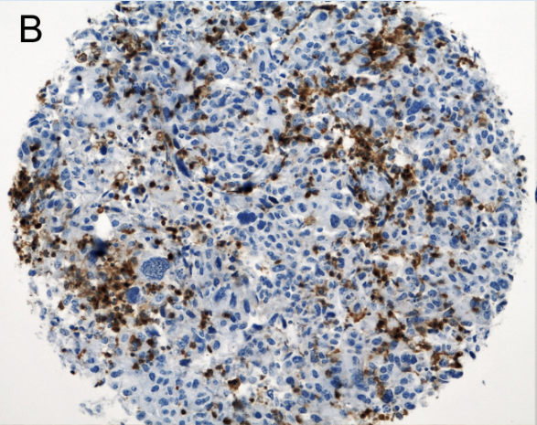
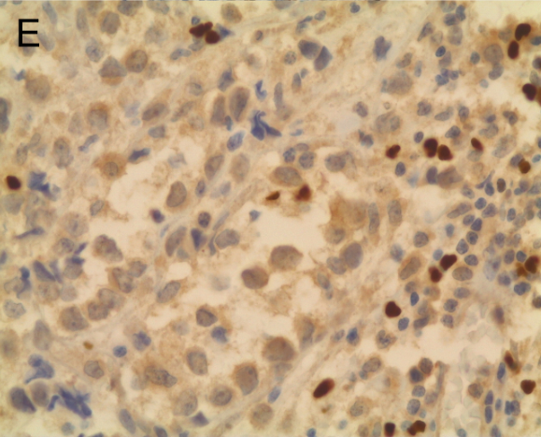
San Antonio Breast Cancer Symposium, December 9-13, 2014
Mechanisms of resistance (trastuzumab)
Biomarker:
quantitation of TILs
activation/signaling state of TILs
circulating cytokines
tumor markers of immunoresistance
gene signatures of immune response
tumor infiltrating lymphocytes
ductal carcinoma; CD4+ immunostain
Droeser et al, BMC Cancer 2012; 12: 34.
This presentation is the intellectual property of the author/presenter.
Contact mark.moasser@ucsf.edu for permission to reprint and/or distribute.

Slide 15
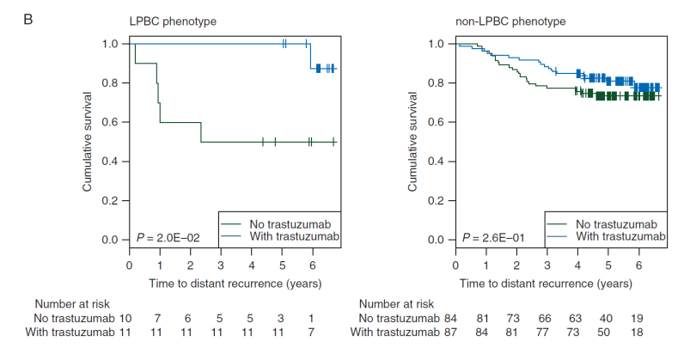
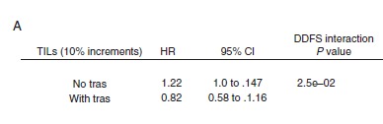
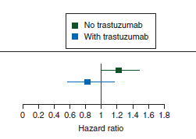
San Antonio Breast Cancer Symposium, December 9-13, 2014
FinHER adjuvant study
N=209 HER2-amplified cases examined by H&E for stromal TILs
Stromal TILs predicts trastuzumab benefit
Loi et al, Annals of Oncol 2014; 25: 1544-50.
This presentation is the intellectual property of the author/presenter.
Contact mark.moasser@ucsf.edu for permission to reprint and/or distribute.

Slide 16
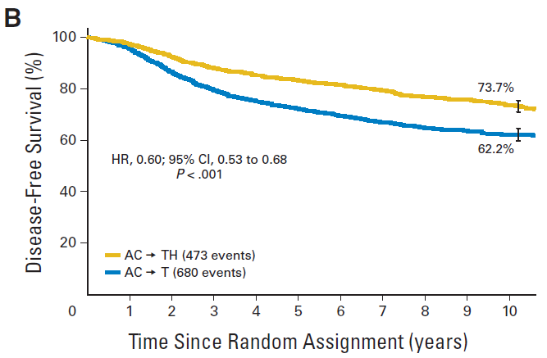
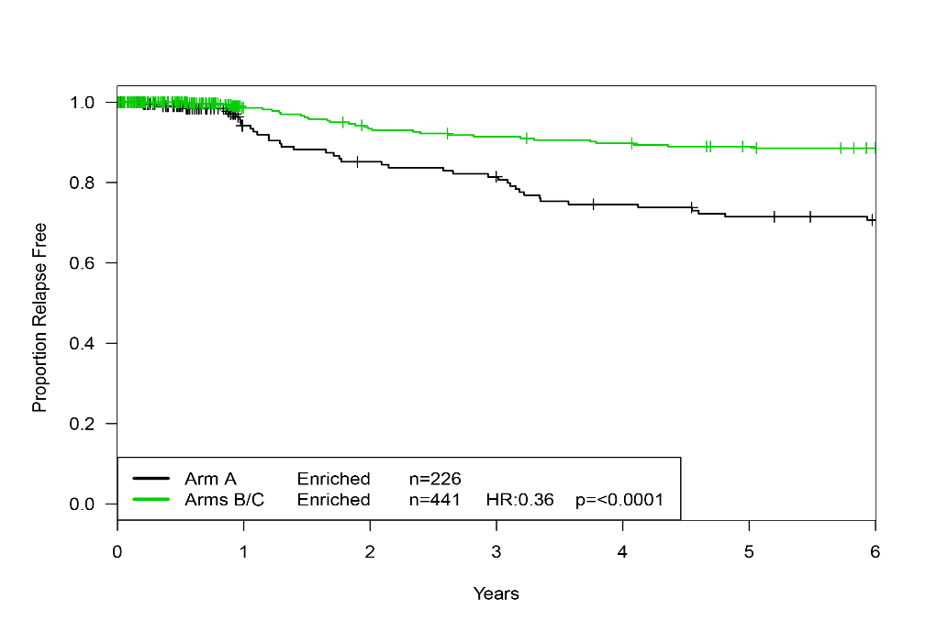
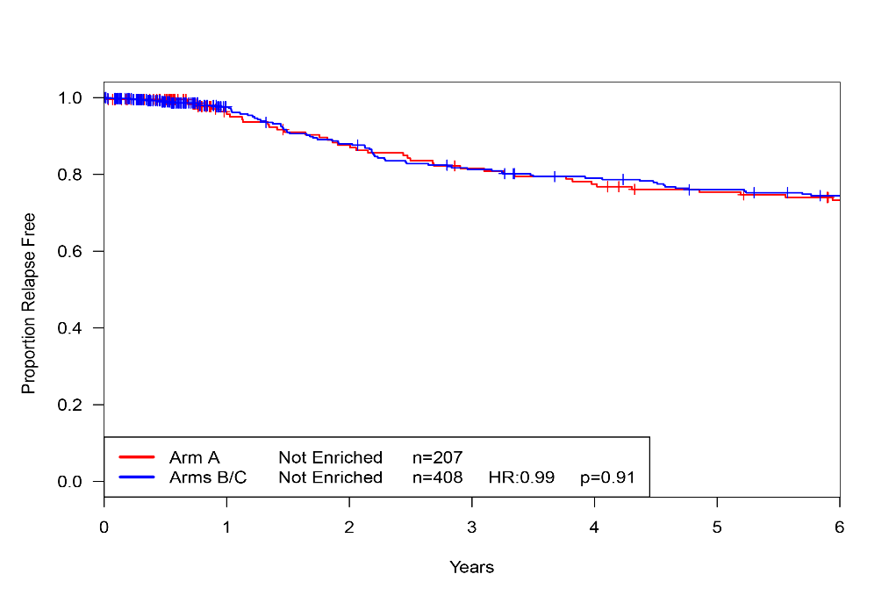
San Antonio Breast Cancer Symposium, December 9-13, 2014
Adjuvant trastuzumab study
NCCGT N9831 + NSABP B-31
N=4046 with 8 year F/U
Perez et al, JCO 2014 (in press)
trastuzumab
control
Immune enrichment PREDICTS trastuzumab benefit
NCCTG N9831 adjuvant study
N=1282 cases performed Illumina 24K whole transcriptome analysis
Immune Enriched Tumors
Immune Not Enriched Tumors
trastuzumab
resistant
tumor
resistant
host
control
Immunological pathways associated with RFS:
Cytokine-cytokine receptor interaction
T-cell receptor signaling in CD8+ T-cells
INF-gamma pathway
TNF receptor signaling pathway
Confirmed by:
Functional interactome analysis (4 of 6 pathways linked with immune)
Gene Ontology analysis (10 of 14 linked with immune)
14-gene signature of immune enrichment
Perez et al, ASCO 2014; Abstract #509.
Perez et al, JCO 2014 (in press)
This presentation is the intellectual property of the author/presenter.
Contact mark.moasser@ucsf.edu for permission to reprint and/or distribute.

Slide 17
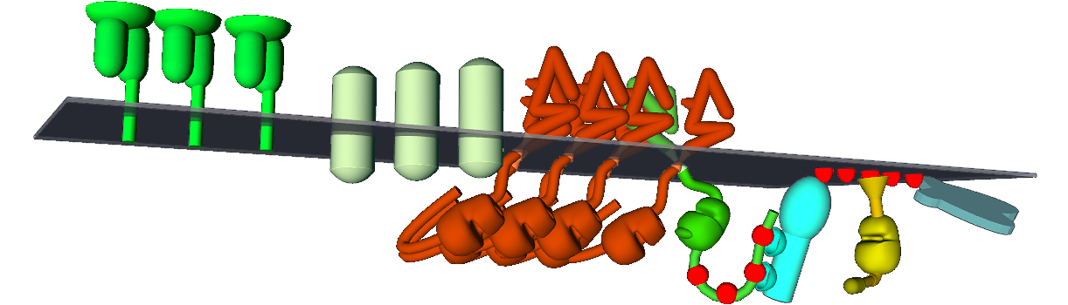
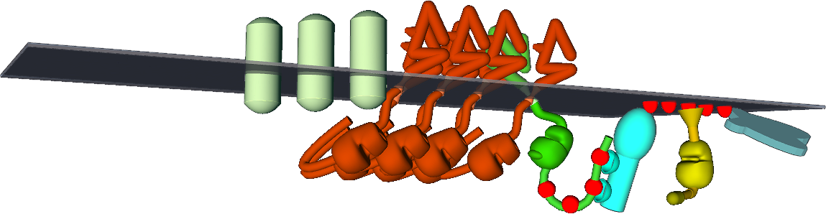
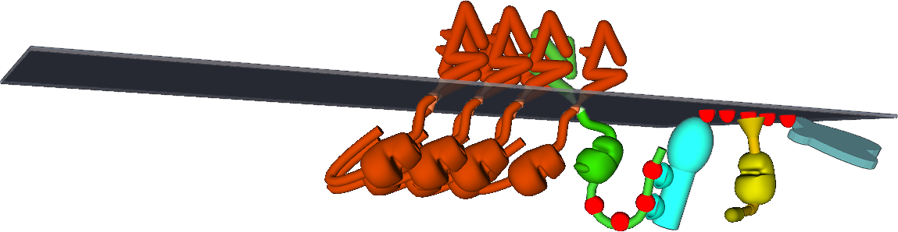
San Antonio Breast Cancer Symposium, December 9-13, 2014
Potential immunomodulatory biomarkers
immuno-recognition
immuno-resistance
MHC cIass I
PD-L1
PTEN
HER2
HER3
AKT
PI3K
Lollini et al, Int J Cancer. 1998; 77: 937-41.
Herrmann et al, Cancer Res. 2004; 64: 215-20
Int J Cancer. 2004; 108: 71-7.
Cancer Immunol Immunother. 2009;58: 653-64.
Int J Cancer. 2011;128: 390-401.
Inoue et al, Oncoimmunology 2012; 1: 1104-10.
Mimura et al, Int J Cancer 2011; 128: 390-401.
Parsa et al, Nature Med 2006; 13: 84-88.
Jaing et al, Clin Cancer Res 2012; 19: 1-12.
Song et al, PLoS One 2013; 8: e65821.
Atefi et al, Clin Cancer Res 2014; 20: 3446-57.
This presentation is the intellectual property of the author/presenter.
Contact mark.moasser@ucsf.edu for permission to reprint and/or distribute.

Slide 18
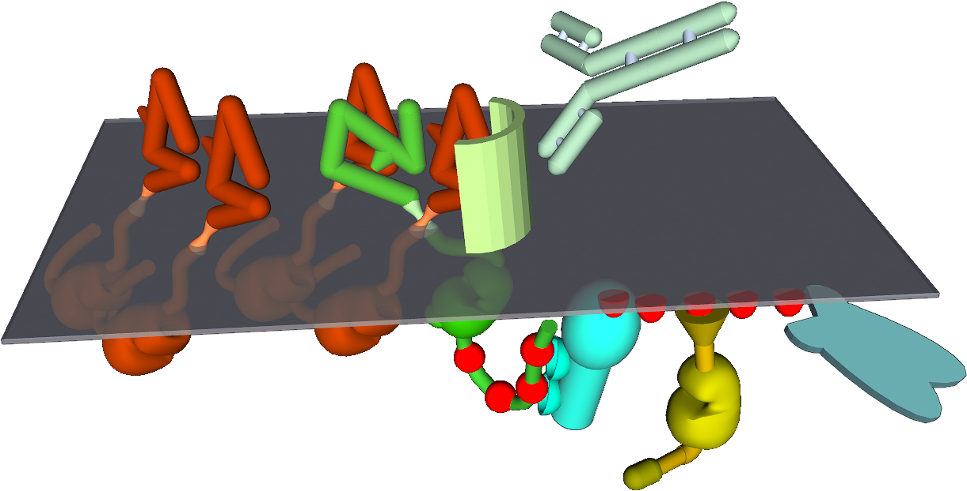
San Antonio Breast Cancer Symposium, December 9-13, 2014
Mechanisms of resistance (trastuzumab)
biomarker = MUC4
epitope masking
trastuzumab
HER2
HER2
MUC4:
Price-Shiavi et al, Int Jour Cancer 2002; 99: 783-791.
Nagy et al, Cancer Res 2005; 65: 473-482.
Hyaluronan
Palyi-Krekk et al. Eur J Cancer 2007; 43:2423-33.
This presentation is the intellectual property of the author/presenter.
Contact mark.moasser@ucsf.edu for permission to reprint and/or distribute.

Slide 19
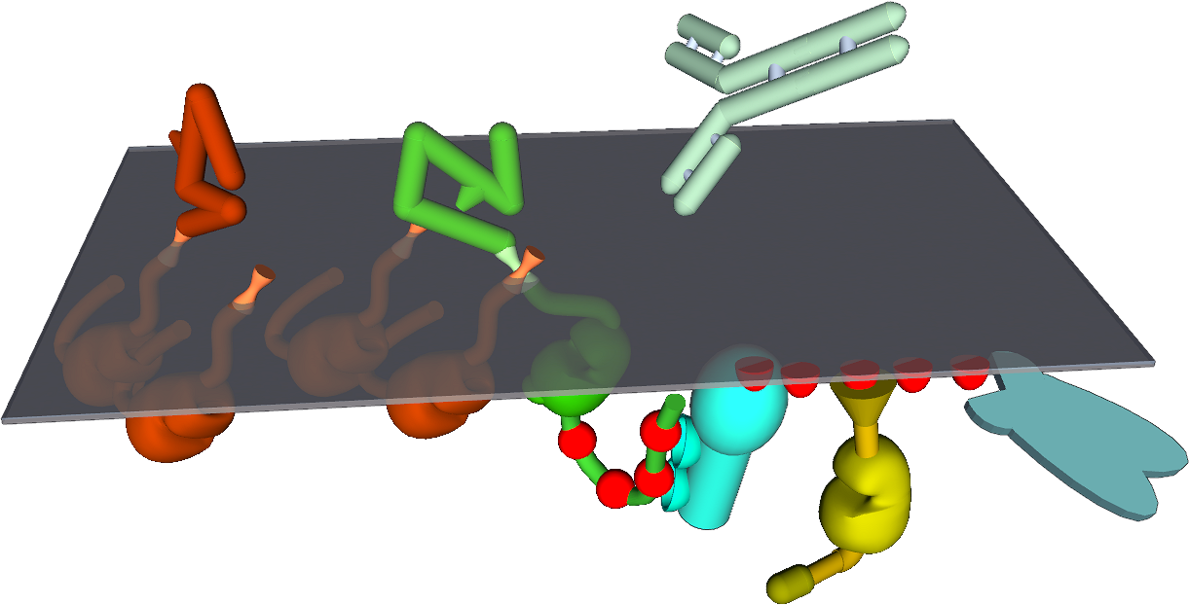
San Antonio Breast Cancer Symposium, December 9-13, 2014
Mechanisms of resistance (trastuzumab)
biomarker = p95HER2
ECD truncation
trastuzumab
HER2
Scaltriti et al, JNCI 2007; 99: 628-38.
Sperinde et al, Clin Cancer Res 2010; 16: 4226-35.
This presentation is the intellectual property of the author/presenter.
Contact mark.moasser@ucsf.edu for permission to reprint and/or distribute.

Slide 20
San Antonio Breast Cancer Symposium, December 9-13, 2014
Mechanisms of resistance
HER2 inhibitors:
widespread / upfront resistance
due to insufficient target inhibition
(HER2-HER3)
resistance in subset
insufficient host immune response
? tumor immuno-resistance
? host attributes, genetics, tolerance
HER2 antibodies:
HER2 ADCs:
(antibody-drug-conjugates)
complex
This presentation is the intellectual property of the author/presenter.
Contact mark.moasser@ucsf.edu for permission to reprint and/or distribute.

Slide 21

Neoadjuvant therapy in HER2-positive breast cancer, latest developments and biomarkers and how it serves as a discovery platform
Sibylle Loibl MD, PhD
German Breast Group
Sana Klinikum Offenbach

Slide 22
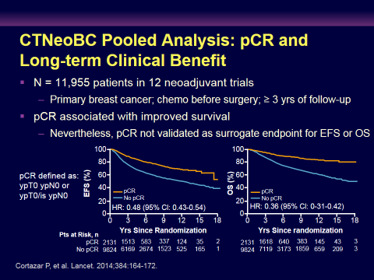
CTNeoBC Meta-análisis: pCR y beneficio clínico a largo plazo
N = 11,955 pacientes en 12 estudios, ≥ 3 años de follow-up
pCR se asoció a mejoría de la OS
  pCR no está validado como subrogante de SLE ó OS
Cortazar P, et al. Lancet. 2014;384:164-172.
Notes:
The FDA supported a meta-analysis to evaluate the outcomes associated with pathologic response to neoadjuvant therapy. In this meta-analysis, 12 neoadjuvant trials were included that enrolled almost 12,000 patients with primary breast cancer who received chemotherapy prior to surgery. There was at least 3 years of follow-up in these studies that were evaluated. This study showed that pathologic complete response did appear to be associated with improved survival.

Slide 23
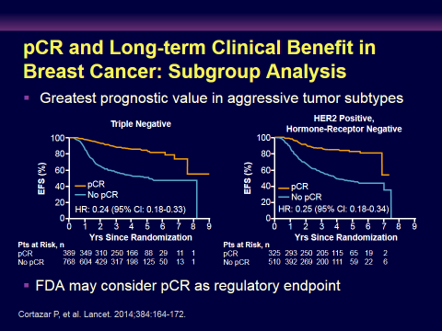
pCR y beneficio clínico a largo plazo: análisis de subgrupo
El mayor valor pronóstico es en los subtipos agresivos
FDA puede considar la pCR como un “endpoint” regulatorio
Cortazar P, et al. Lancet. 2014;384:164-172.

Slide 24

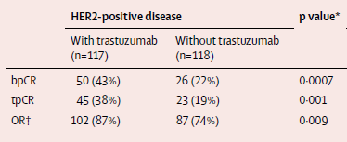
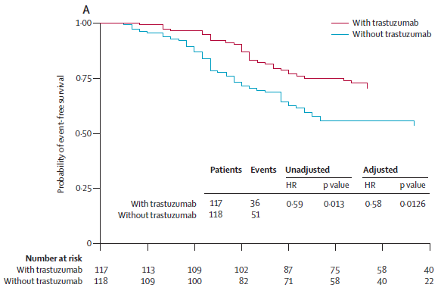
Increase in pCR by trastuzumab correlates with better prognosis (NOAH – trial)
Gianni L, et al. NOAH study The Lancet 2010; Lancet Oncol 2014

Slide 25
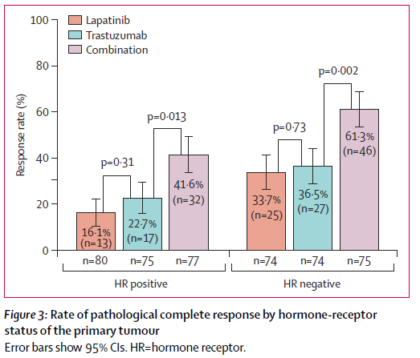
Neo-Altto pCR rate and LANDMARK ANALYSIS: EFS BY PCR
All patients
Tests for interaction: pCR x HR p=0.34
Baselga J Lancet 2012; Piccart M, et al. SABCS 2013,
Azambuja E et al. Lancet Oncol 2014

Slide 26
Increase in pCR
74%
65%
Long CHT + dual anti-HER2 therapy
Long CHT +Trastuzumab similar to short CHT+duale anti-HER2
Short CHT +Trastuzumab
CHT alone
48%
45%
38%
25%
20%
15%
Notes:
Figure 1: Increase in pCR by using different treatment regimen.

Slide 27
pCR rates in HER2-positive BC
ypT0/is ypN0
GeparQuinto¹
Neosphere²
NeoAltto³
Tryphaena⁴
GeparSixto
¹ Untch TLO 2012, ²Gianni TLO 2012, ³Baselga Lancet 2012, ⁴Schneeweiß, SABCS 2011

Slide 28
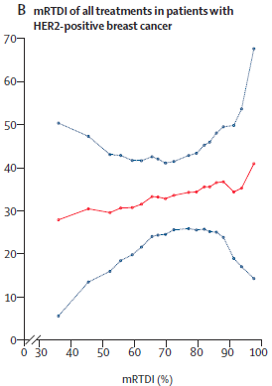
Carboplatin in HER2+ b.c. in addition to Paclitaxel and NPLD GeparSixto; GBG 66): a randomised phase 2 trial.
HER2-positive
n.s.
N=136
N=137
von Minckwitz et al. Lancet Oncol 2014

Slide 29
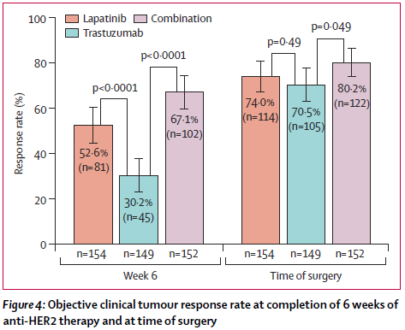
Clinical Response w/o CHTx
Baselga J, et al. Lancet 2012

Slide 30

Anti-HER2 Tx w/o chemoTx
TH (n=107)
docetaxel (75→100 mg/m²)
trastuzumab (8→6 mg/kg)
S
U
R
G
E
R
Y
TCBRC006
THP (n=107)
docetaxel (75→100 mg/m²) trastuzumab (8→6 mg/kg)
pertuzumab (840→420 mg)
HP (n=107)
trastuzumab (8→6 mg/kg)
pertuzumab (840→420 mg)
TP (n=96)
docetaxel (75→100 mg/m²) pertuzumab (840→420 mg)
Study dosing: q3w x 4
Gianni L, et al. Lancet Oncol 2012;
Rimawi M et al. J Clin Oncol 2013

Slide 35
PredictORS for HER2+ breast cancer

Slide 36


Hormone Receptor Status as Predictor for pCR after Neoadjuvant Treatment
50
Neo-Altto
40
30
46
pCR, % ± 95% CI
20
29
10
24
17
0
TH
THP
HP
TP
70
ER or PR positive
60
ER and PR negative
50
63
NEOSPHERE
40
pCR, % ± 95% CI
30
20
37
10
29
30
26
Robidoux A et al. Lancet Oncol. 2013
Baselga J et al. Lancet 2012; Gianni L, et al. Lancet Oncol 2012
20
6
17
0
TH
THP
HP
TP
Notes:
Dia 7 und 8 tauschen

Slide 37

PAM50 compared to HR status in NOAH
Prat A, et al. Clinical Cancer Res 2014

Slide 38
C40601: Schema
Research
tissue
Research tissue
wT+H+L x 16wks
S
U
R
G
E
R
Y
Clinical stage II-III HER2+
Recommended:
Dose-dense AC ➔ H x 34 wks
R
wT+H x 16wks
* Except T4d
wT+L x 16wks
*wT= weekly paclitaxel, H=trastuzumab, L=lapatinib
Primary endpoint: pCR breast (*ASCO 2013)
Secondary endpoints:
Clinical: pCR breast + axilla*, Toxicity*, RFS, OS
Correlative science (*)
Carey L et al. J Clin Oncol 35 s, # 500

Slide 39
C40601: HER2+ Subtypes by Hormone Receptor (HR)
Normal-like 7%
Normal-like 10%
Lum B 6%
Basal-like 15%
HER2-E 18%
Lum B 34%
Lum A 16%
HER2-E 52%
Lum A 43%
Carey L et al. J Clin Oncol 35 s, # 500
Note: Receptors not centrally reviewed

Slide 40
pCR by Arm and Intrinsic Subtype Compared to Split by HR Status
%
N=11
N=52
N=51
N=35
N=123
N=173
Carey L et al. J Clin Oncol 35 s, # 500

Slide 41




Slide 42
Multivariable Analysis* for Prediction of pCR in HER2+ Breast Cancer
 |  | Odds ratio | 95% CI | P-value
PIK3CA | wt | 1.00 |  | 0.01
 | mut | 0.49 | 0.29-0.85
Hormone receptor status | neg | 1.00 |  | 0.001
 | pos | 0.50 | 0.33-0.75
* adjusted for therapy, age, tumour and nodal status, histotype and grading, study and anti-HER2 therapy
Loibl S et al. J Clin Oncol 2014
Notes:
Umkodieren, um OR >1 zu bekommen

Slide 43
PIK3CA mut status and pCR
GBG studies
ypT0/ypN0
NeoAltto
ypT0/is
CHERLOB ypT0/is, ypN0
pCR
P= 0.012
P=0.007
P=0.06
N=173
N=91
N=240
N=112
N=124
N=119
N=~35
N=~35
N=~35
N=108
Loibl S et al. J Clin Oncol 2014; Baselga J et al. ECC 2013; Guarneri V et al. ESMO 2014

Slide 44
PIK3CA and PTEN as predictor in HER2+ w/o CHT
pCR %
None of the patients whose tumors harbored a PIK3CA mutation achieved pCR (p=0.06).
There was no association between PTEN status and PIK3CA mutation (p=0.44).
0/17 cases (0%) with a mutation and/or PTEN low expression (<100 H score) had a pCR compared to 5/14 cases (36%) with PI3KCA wild type and high PTEN levels (p=0.01).
P=0.04
Loibl S et al. PD5-7
PTEN and PIK3CA but not p4EBP1 are associated with low rates of pathological complete response (pCR) to trastuzumab
Contreras H SABCS 2013 PD 1-2

Slide 45



NeoPHOEBE: Pi3k inhibition in Her2 OverExpressing Breast cancEr:
Phase II, randomized, two stage, placebo-controlled
6 Weeks
12 Weeks
Trastuzumab +
Placebo
Trastuzumab + Paclitaxel +
Placebo
RANDOMIZATION
PIK3CA mutant
Trastuzumab +
BKM120
Trastuzumab +
BKM120 +
Paclitaxel
Trastuzumab + Paclitaxel +
BKM120
HER2+
>2cm
Newly diagnosed
SURGERY
ENDPOINT: RATE OF pCR PER COHORT
Trastuzumab +
Placebo
Trastuzumab + Paclitaxel +
Placebo
RANDOMIZATION
PIK3CA
Wild-type
Trastuzumab +
BKM120
Trastuzumab +
BKM120 +
Paclitaxel
Trastuzumab + Paclitaxel +
BKM120
Loi S et al. SABCS 2013

Slide 46

sTIL as Predictor in HER2+
Loi S, et al. SABCS 2013

Slide 47
Window- of opportunity

Slide 50
Postneoadjuvant therapy

Slide 51
Postneoadjuvant concept for HER2+ bc
Completion of up to one year anti-HER2 treatement
≈50%
pCR
Anthra-cycline
Taxane
S
U
R
G
E
R
Y
No additional anti-HER2 therapy
HER2 positive breast cancer patients
Anti-HER2
6-8 cycles Anthracycline/Taxane based chemotherapy anti-HER2 treatment
Completion of up to one year trastuzumab
≈50%
Non pCR
Completion of up to one year with trastuzumab plus investigational drug
months
0
18-24
52

Slide 52
Katherine: Study Schema
SURGERY
Preoperative therapy:
Trastuzumab/
Taxane ± Anthracycline
Trastuzumab
Residual
invasive tumor
T-DM1
Radiation per standard guidance; hormone therapy if ER or PgR pos
Geyer C et al. SABCS 2013
Notes:
Enrollment (based on stats/primary endpoint). The study population includes patients who have received preoperative therapy with trastuzumab and a taxane followed by surgery. Patients are eligible for the study if they have residual invasive disease in the breast or axillary lymph nodes (non-pCR).

Slide 53
Summary
Double-blockade
  Significantly higher pCR rates
  ER+: double-blockade +ER treatment as sole therapy?
  PIK3CA genotype is associated with significant lower pCR rates
Predictors
  ER-status
  PIK3CA status
  TILs
Study Designs
  Window-of opportunity studies
  Post-neoadjuvant studies for new treatment options

Slide 61


